Slide 1
Project 9: EKF-based Localization with LRF
Presentation 2:
Progress, Theory and Outlook
Notes:
Last but hopefully not least, second presentation about our project. Project number 9: Extended Kalman Filter based Localization using a Laser Range Finder

Slide 2
Outline
Progress
Robot
Theory
Outlook
Questions
Notes:
What are the topics I am going to talk about?
First up is the progress we were able to achieve in the last 3 weeks. On the one hand robot based progress and on the other hand also progress in understanding the EKF.
This is followed by a short outlook on what we aim for in the next 3 weeks and then I am going to end the presentation with some question.

Slide 3
Outline
Progress
Robot
Theory
Outlook
Questions
Notes:
So let‘s do not waste any time and get started.

Slide 4
Progress
3 weeks ago:
General idea about our task, ROS and the EKF
Update
Prediction
Matching
Solution Approach:
Mapping the room
Combining pre-acquired map with the mapped room
Building autonomy
Optimizing for the problem
EKF
Notes:
This is a brief summary of what Thiago presented to you last time and what basically was our position at that time. We had a general idea about our task, about ROS and about the EKF. We used this extremly superficial model to sum up the EKF. Additionally we showed a 4 step solution approach, which first step was to map the room. So this was where we started 3 weeks ago. What do we have now?

Slide 5

Robot (1)
Today:
Working ROS Environment
Communication with Robot (ROSARIA)
LRF & Odometry connected to RVIZ
Remote control robot with keyboard from second laptop
First version of a map of the 5th floor (slam_gmapping)
First step of the solution approach
Notes:
Today we have a working ROS environment, which includes the communication with the robot, using the Rosaria package. We are also able to connect the LRF and the Odometry to RVIZ.
We can control the robot by using the keyboard and even use a second laptop to remote control the robot.
Yesterday we were able to obtain a first version of a map of the 5th floor corridor using the slam_gmapping package. So we were able to finish the first step of our formulated solution approach.
In order to prove these things we prepared a video, that we recorder yesterday.

Slide 6
Robot (2)
VIDEOS
Notes:
Goncalo remote controlling the robot
LRF on the front side. Remote controlling does not only look cool, it is also useful for mapping corners.
Here you can see the mapping in the RVIZ This part obviously also is a lot of fun.

Slide 7
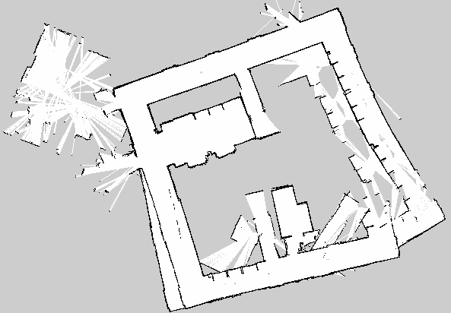
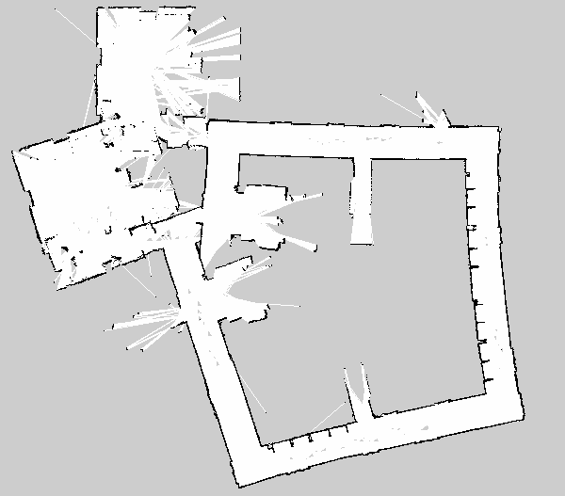
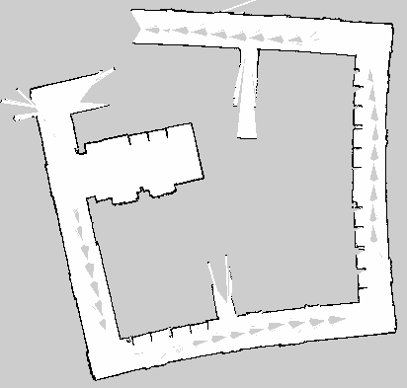
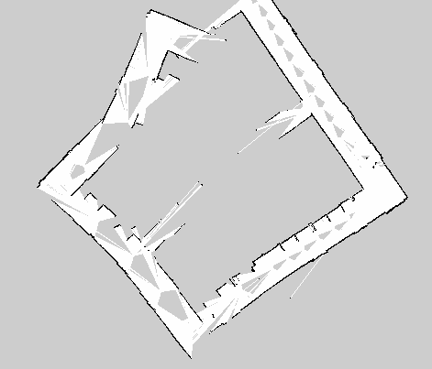




Robot (3)
$$a) 2 laps$$
$$b) 1 lap$$
$$d) fast$$
$$c) slow$$
Notes:
So far we mapped the corridor 4 times. We used different settings and methods for this. Results are showen here.
Good: Elevator part. Class room, some straight parts
Bad: Straights are not straight → Closing the map does not work

Slide 8
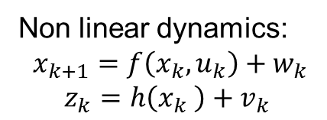
Theory (1)
Approximation by linearization around last state estimate
Linearization has to be a good approximation to be valid
Otherwise the EKF may even diverge
Non linear dynamics:
$$x_{k+1}=f\left(x_{k},u_{k}\right)+w_{k}$$
$$z_{k}=h\left(x_{k} \right)+v_{k}$$
Observations
Matching
Prediction
Update
Odometry
Observation model
World Map
Based on the EKF localization slides
Notes:
Enought to robot progress, let‘s continue with progress in understanding the EKF This is a basic but more detailed in comparison to the last time, model of the EKF. EKF is used for systems with non linear dynamics. State in next time step equals f, which depends state and input) + process noise. Observation equals h + observation noise.
The non linear dynamics cause non gaussian pdf., which makes it hard to determine the mean and the variance. That‘s why a linearization is used as an approximation.
In which parts is this linearization used? f: nonlinear state function
h: nonlinear observation function
w: process noise (white & gaussian)
v: measurement noise (white & gaussian)

Slide 9
Theory (1)
Approximation by linearization around last state estimate
Linearization has to be a good approximation to be valid
Otherwise the EKF may even diverge
Non linear dynamics:
$$x_{k+1}=f\left(x_{k},u_{k}\right)+w_{k}$$
$$z_{k}=h\left(x_{k} \right)+v_{k}$$
Observations
Matching
Linear models
Prediction
Update
Odometry
Observation model
World Map
Based on the EKF localization slides
Notes:
In the prediction block
Linearized system dynamics are used for the odometry prediction
In the observation model linearized observation dynamics are used

Slide 10


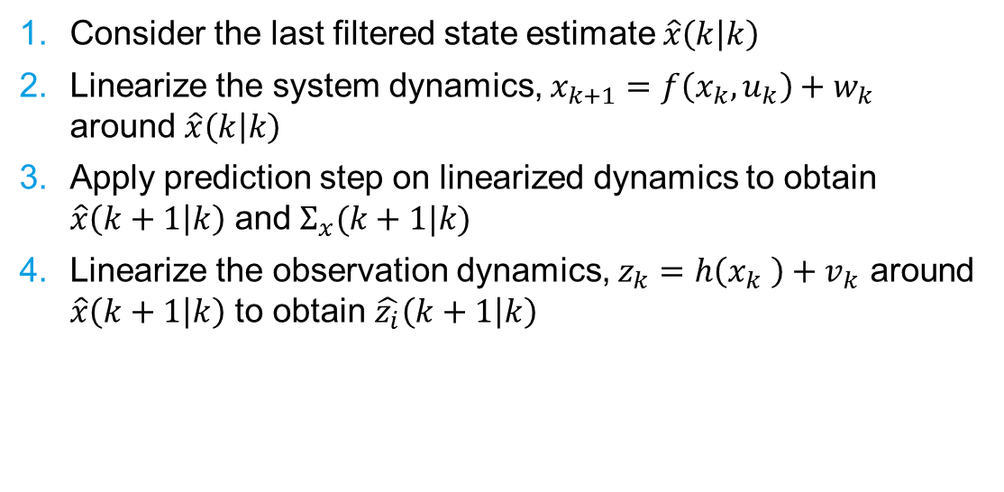

Theory (2)
Consider the last filtered state estimate $\hat{x}\left(k | k\right)$
Linearize the system dynamics, $x_{k+1}=f\left(x_{k},u_{k}\right)+w_{k}$ around $\hat{x}\left(k | k\right)$
Apply prediction step on linearized dynamics to obtain $\hat{x}\left(k+1 | k\right)$ and${ Σ}_{x}(k+1|k)$
Linearize the observation dynamics, $z_{k}=h\left(x_{k} \right)+v_{k}$ around $\hat{x}\left(k+1 | k\right)$ to obtain $\hat{z_{i}}\left(k+1 | k\right)$
Observations
Matching
$$\hat{z_{i}}\left(k+1 | k\right)$$
Prediction
Update
Odometry
Observation model
World Map
$$\hat{x}\left(k | k\right)$$
$$Σ_{x}(k|k)$$
$$\hat{x}\left(k+1 | k\right)$$
$$Σ_{x}(k+1|k)$$
Based on the EKF localization slides
Notes:
Let’s have a look on how the EKF works. 1. Consider the last filtered state estimate $\hat{x}\left(k | k\right)$ As the prediction used the linearized model, giving the mean and the variance is enough to get a gaussian probability density function
2. Linearize the system dynamics, $x_{k+1}=f\left(x_{k},u_{k}\right)+w_{k}$ around $\hat{x}\left(k | k\right)$
3. Apply the prediction step of the Kalman filter to the linearized system dynamics
t$o obtain \hat{x}\left(k+1 | k\right)$ and ${ Σ}_{x}(k+1|k)$
4. Linearize the observation dynamics, $z_{k}=h\left(x_{k} \right)+v_{k}$ around $\hat{x}\left(k+1 | k\right)$ and use this to get a observation prediction

Slide 11



Theory (3)
Try to match the real observation with the predicted one
Update the current state
Observations
$$z_{j}(k+1)$$
Matching
$$\hat{z_{i}}\left(k+1 | k\right)$$
$$no$$
$$yes$$
Prediction
Update
Odometry
Observation model
World Map
$$\hat{x}\left(k | k\right)$$
$$Σ_{x}(k|k)$$
$$\hat{x}\left(k+1 | k\right)$$
$$Σ_{x}(k+1|k)$$
Based on the EKF localization slides
Notes:
5.
6.
That is the general model. For our case we can change two small things

Slide 12
Theory (4)
LRF
$$z_{j}(k+1)$$
Matching
$$\hat{z_{i}}\left(k+1 | k\right)$$
$$no$$
$$yes$$
Prediction
Update
Odometry
Observation model
Map
$$\hat{x}\left(k | k\right)$$
$$Σ_{x}(k|k)$$
$$\hat{x}\left(k+1 | k\right)$$
$$Σ_{x}(k+1|k)$$
Based on the EKF localization slides
Notes:
On the one hand we know that the observation will be made by our LRF. And on the other hand the world map is our pre acquired map

Slide 13
Outline
Progress
Robot
Theory
Outlook
Questions
Notes:
So how will we use this knowledge and continue our work on the project

Slide 14
Outlook (1)
LRF
Improve!
Matching
Prediction
Update
Odometry
Observation model
Map
Based on the EKF localization slides
Notes:
You can see, I really like this model.
This time it shows what we have right now. We are able to get the raw data from the LRF and we are also able to obtain the map, which, let‘s be honest, we still need to improve massively.
So what do we need to do next? Ît is as simple as this: We need to implement the EKF

Slide 15
Outlook (2)
Implementing the EKF
Odometry prediction
Observation model
Matching
Update
LRF
Matching
Prediction
Update
Odometry
Observation model
Map
Based on the EKF localization slides
Notes:
This includes the 4 parts: odometry prediction, the observation model, the matching and the updating.
Some of these parts will probably be harder than others. But in difference to the last 3 weeks, we hope, that we can parallelize some of the work.
In three weeks we will tell you how good that idea worked out.

Slide 16
Questions
Will the wheels be recalibrated?
Notes:
As we just finished the mapping part yesterday, we honestly dont have too many questions on the upcoming parts. The only thing we bothered about obviously was the not straight driving robots.

